Slide 1
STOCK MANAGEMENT SYSTEM IN C
Presented by S.ANIL -24KB1A04Y7
G.BHARATH KUMAR -24KB1A0499
G.AKHIL SAI -24KB1A04A1
G.UDAY KUMAR -24KB1A04B8
PRESENTED BY: ALPHA SQUAD 45

Slide 2
OBJECTIVES
CREATING STOCK
Show All Stocks
Update Stock
Delete Stock
Highest Price
Lowest Price
Search Stock
Count Stocks
Sort by Name10. Exit

Slide 3
INTRODUCTION
Manage and track stock prices dynamically.
Features: Add, Display, Find Highest/Lowest stock prices.
Efficient use of linked list for memory management.

Slide 4
DATA STRUCTURE
struct Stock {
char name[20];
float price;
struct Stock *next;
}
Linked list dynamically manages stock entries.

Slide 5
CORE FUNCTIONS
createStock(): Create a new stock node.
addStock(): Insert stock at the beginning.
findHighest(): Find stock with max price.
findLowest(): Find stock with min price.
printStocks(): Display all stock data.

Slide 6
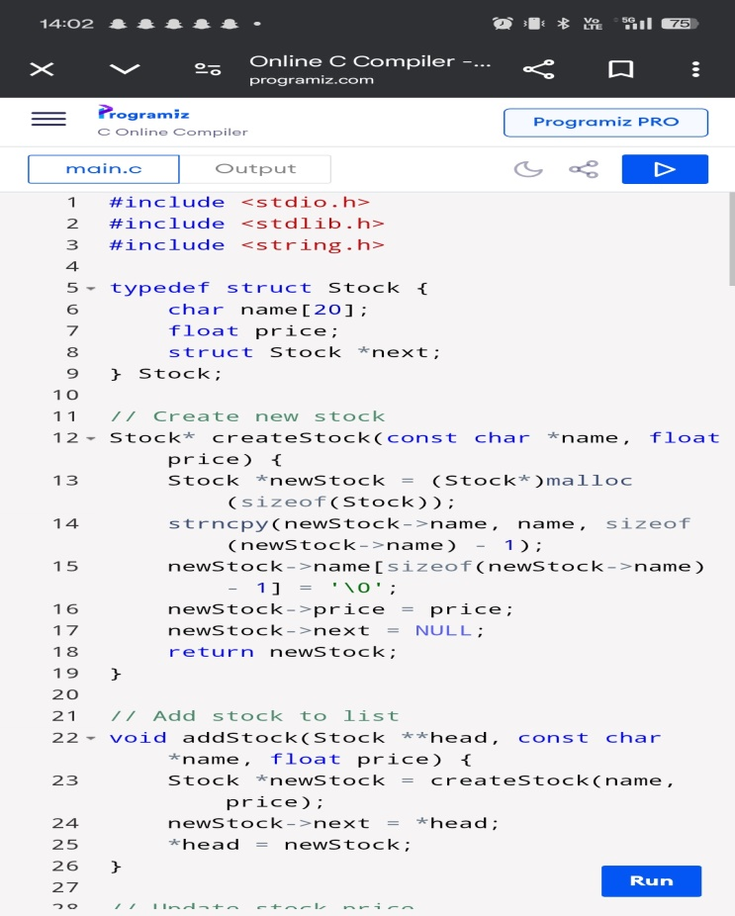
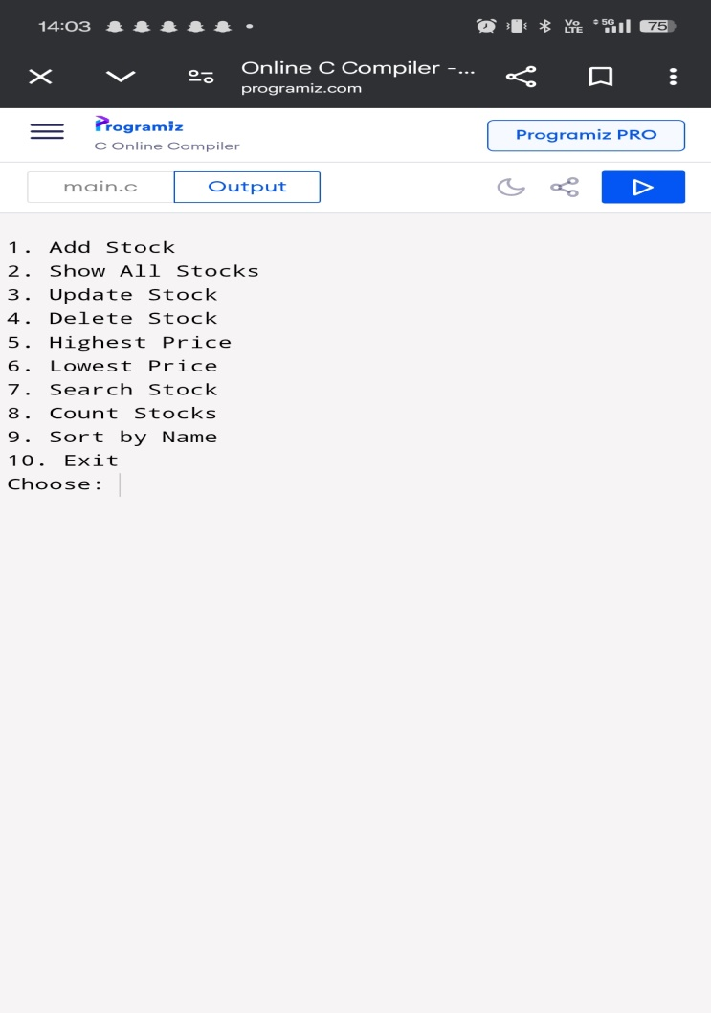
PROGRAM FLOW
User Menu:
- Add Stock
- Show All Stocks
- Find Highest Price
- Find Lowest Price
- Exit

Slide 7
PROGRAM EXICUTION
https://www.programiz.com/online-compiler/1LhUzm0pWSWu3

Slide 8
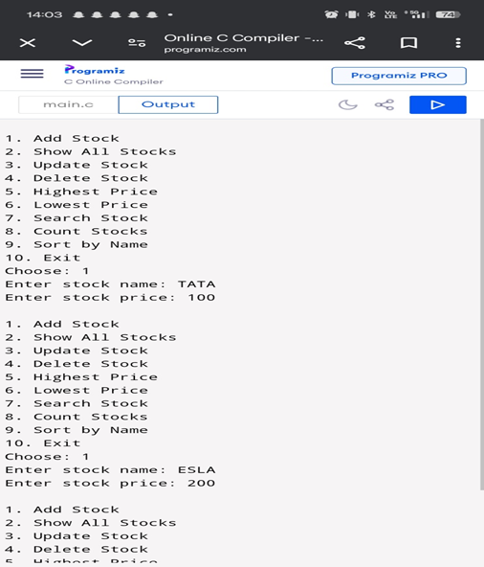
CONCLUSION
Dynamic and efficient stock management.
Linked list enables easy addition/removal.
Expandable: sorting, searching, more features.

Slide 9
THANK YOU

